Slide 1

Late Shipment Order Analysis
Shreya Bagchi

Slide 2
Introduction
Church and Dwight is one of the fastest growing consumer packaged goods company, headquartered in New Jersey, USA , with products in personal care, market household and speciality products.
Brands: Arm & Hammer, Trojan, First Response, Orajel, OxiClean, Nair and Spin Brush.
About 34% of the total sales of Church & Dwight comprises of the personal care products.
Walmart, Target or Amazon are some of the leading customers which sells different branded products of Church and Dwight.

Slide 3
Project Goals
The aim of this project is to examine the late orders for Church and Dwight and see if any trend or pattern exists.
A ‘late order’ is defined as an order where the revenue recognition month is different than the requested delivery month.
Identify customer(s) who are specifically driving the late orders.
Examine how the average late-period of these customers vary with others.
To broadly classify the customers based on average shipment volume and see how each of these classified groups impact the late order trend.
To identify the features which might contribute to the late order shipment and build a model to predict the probability of the late order.
Eventually build a Time-series model that can forecast the future late orders

Slide 4
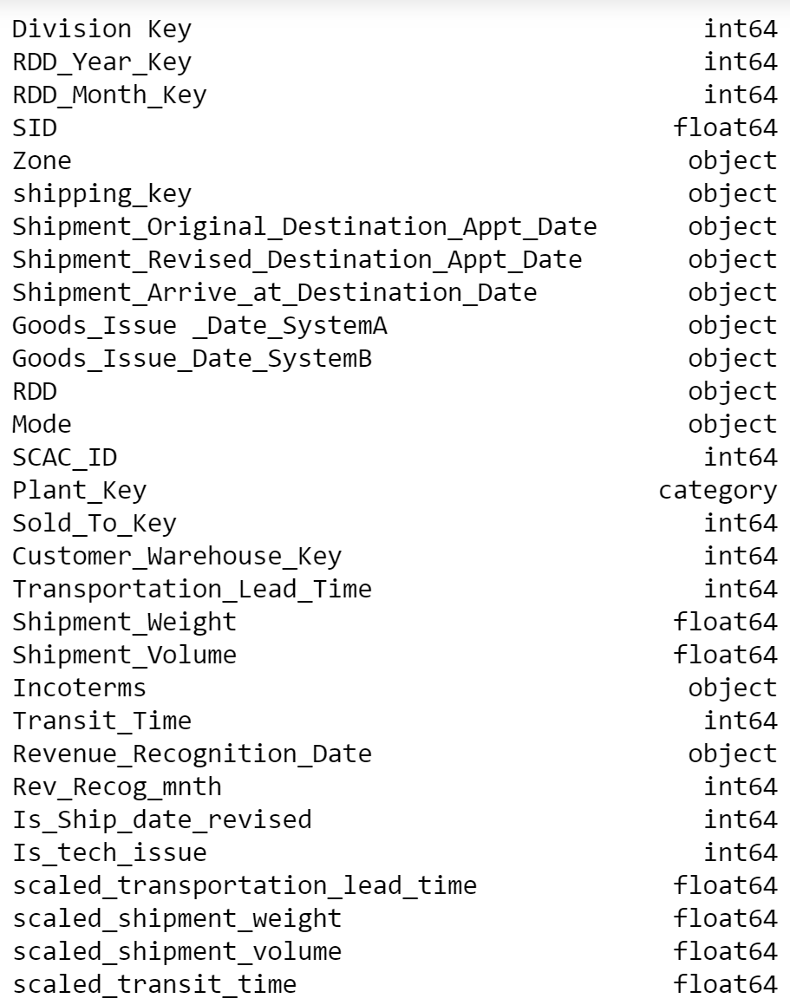
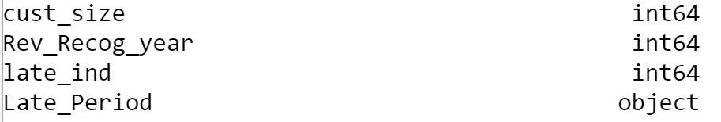
Data
This dataset spans from 2014 till 2017
It comprises of 460309
rows and 23 columns/fields.
Additionally, few more columns
have been added, namely
Late_Ind - This field is a binary one.
If the order is late, its value is 1, otherwise.
Is_Ship_date_revised - If the “Shipment Original
Destination Appt Date” is different than
‘Shipment Revised Destination Appt Date’,
value is 1, otherwise 0.
Is_tech_issue –1 if technical issue is present,
otherwise 0.
cust_size – all the customers were classified
based on shipment volume.
Late_Period – late period was calculated by
the difference
between ‘shipment arrive at destination Date’ and the RDD.

Slide 5
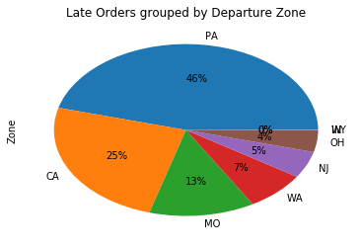
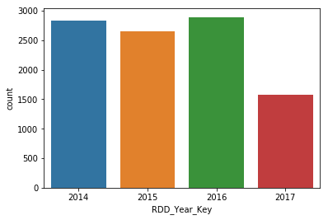
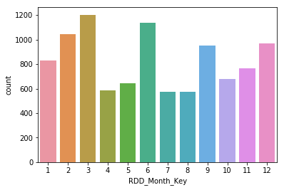
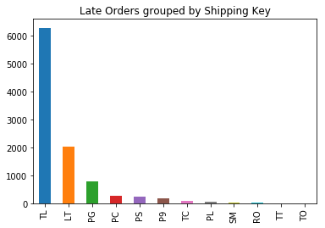
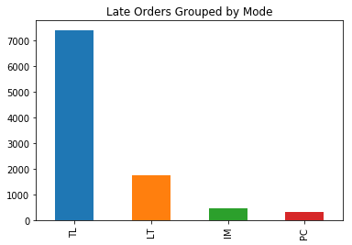
Exploratory Data Analysis
Distribution of Late orders Yearwise Monthwise

Slide 6
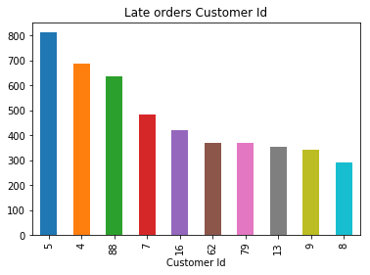
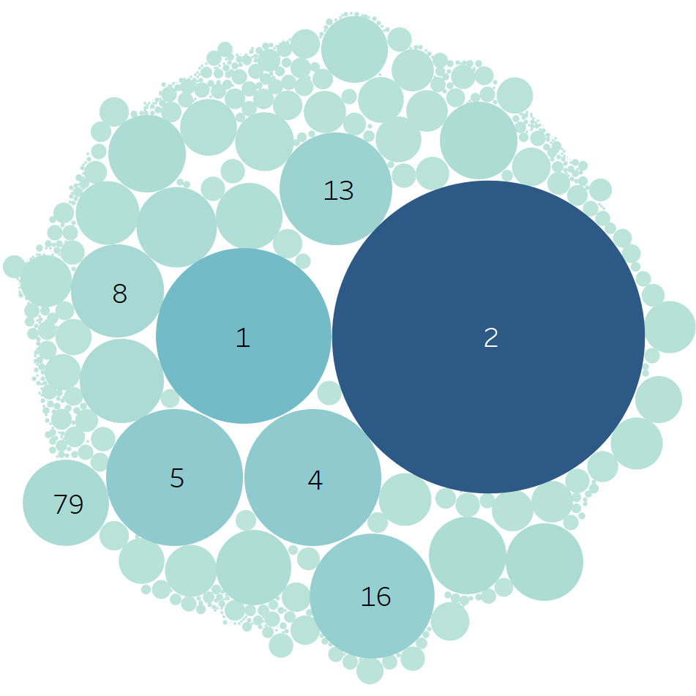
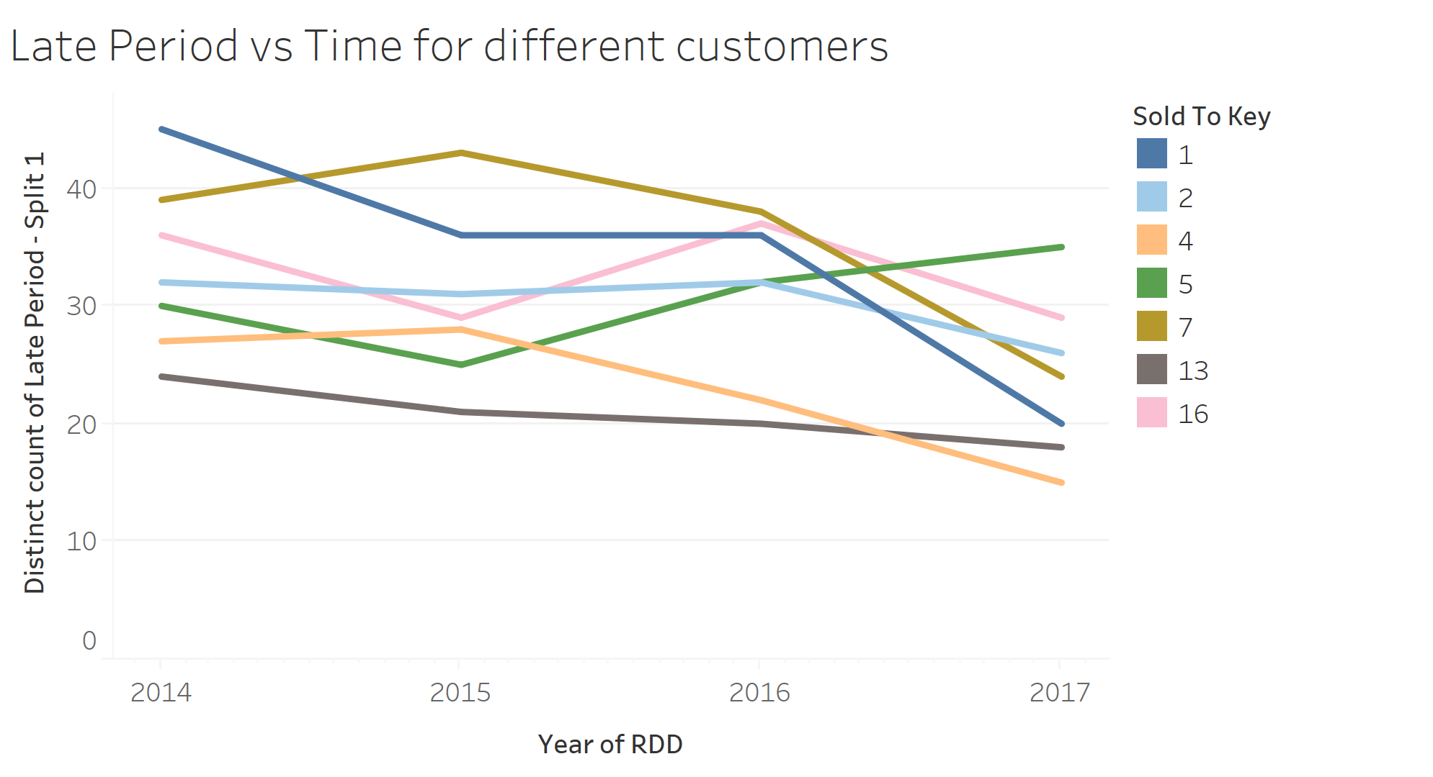
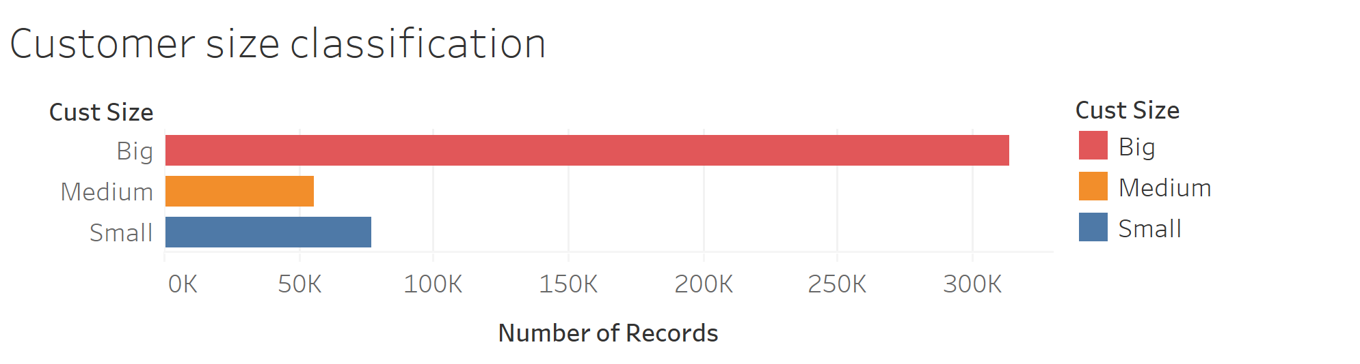
How customer-size is based on shipment vol
Customers with high late frequency

Slide 7
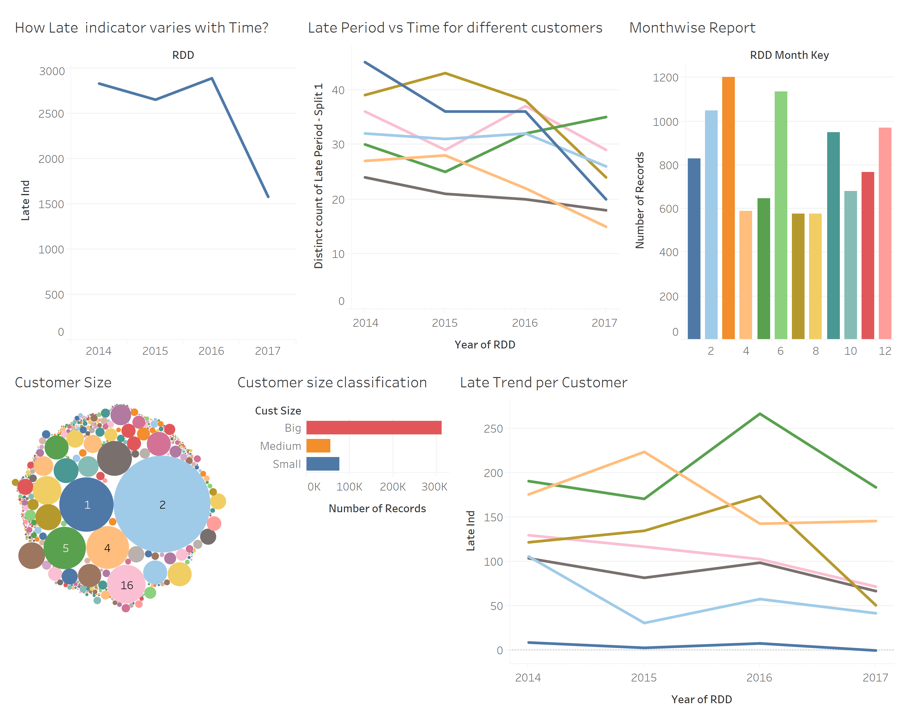
Church and Dwight Dashboard

Slide 8
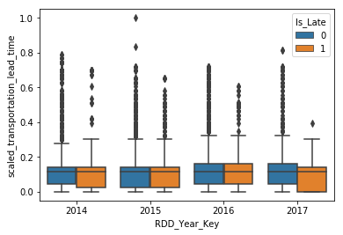
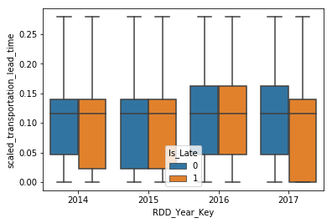
EDA contd…
Data Cleaning - Missing values identification and removal. Attributes include Mode, Transportation Lead Time
Attribute Scaling – Using Min-max method. Targeting numeric attributes transportation lead time, shipment weight, shipment volume and transit time.
Encoding categorical attributes using One-Hot Encoding. Targeting attributes like Mode, Zone, Shipping Key and Incoterms.
Outlier Detection and Removal – Before and After
Be

Slide 9
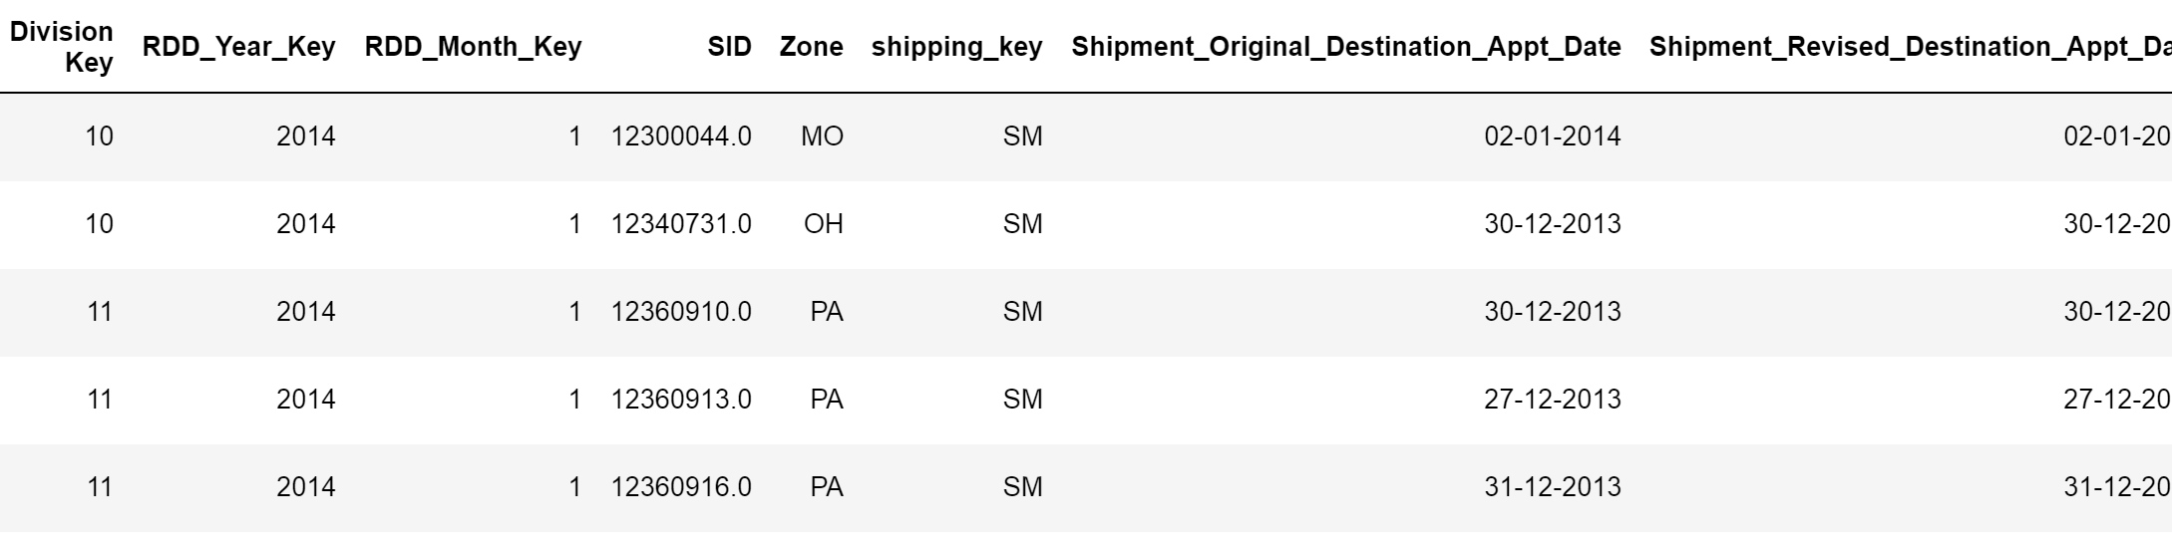
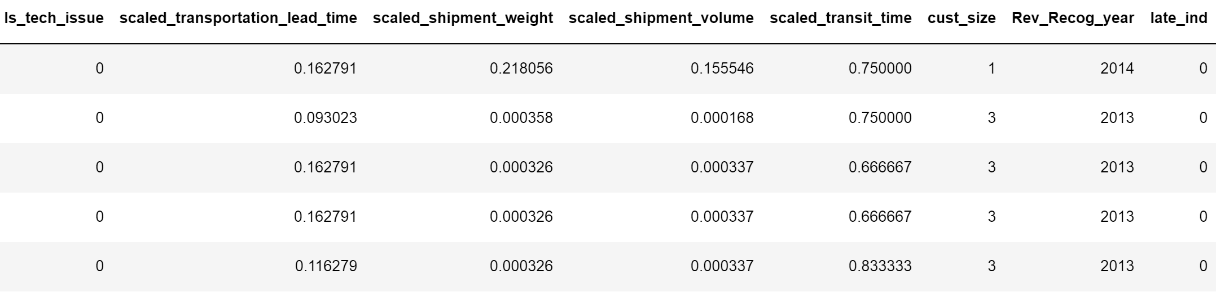
Processed Data Snapshot

Slide 10
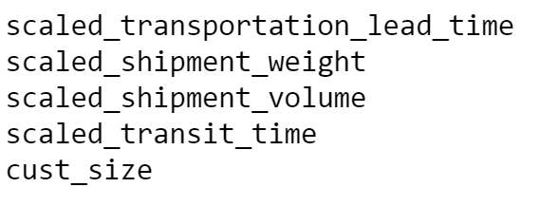
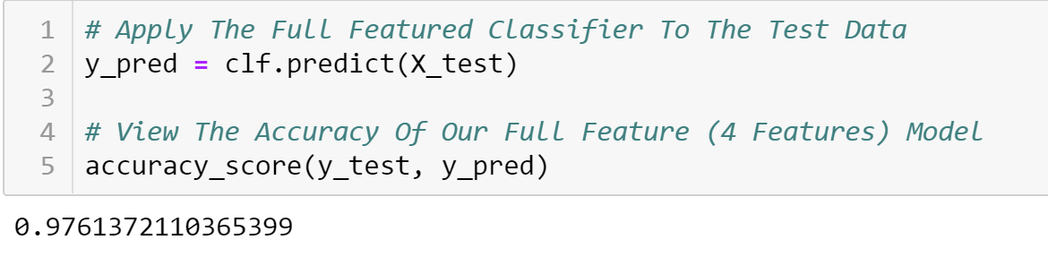
Feature Selection
Algorithms Used:
Random Forest Classifier
Forward Selection
Backward Elimination
Stepwise Regression
Model Accuracy:
scaled_transportation_lead_time scaled_shipment_weight Is_tech_issue
Is_Ship_date_revised
mode_IM mode_PC mode_LT zone_CA
zone_NJ
zone_WA
zone_IN
zone_PA ship_key_TL ship_key_PG ship_key_P9 ship_key_PS ship_key_PL ship_key_RO
ship_key_TO ship_key_SM incoterms_DAP
Notes:
Note: Random Forest Classifier only selects the Top 5 attributes
Chi-square test did not produce any significant output. Chi-square test measures the chi-sq between each predictor variable and the target variable

Slide 11
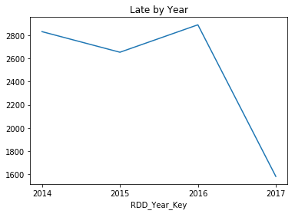
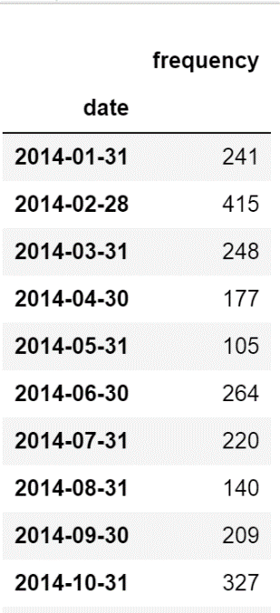
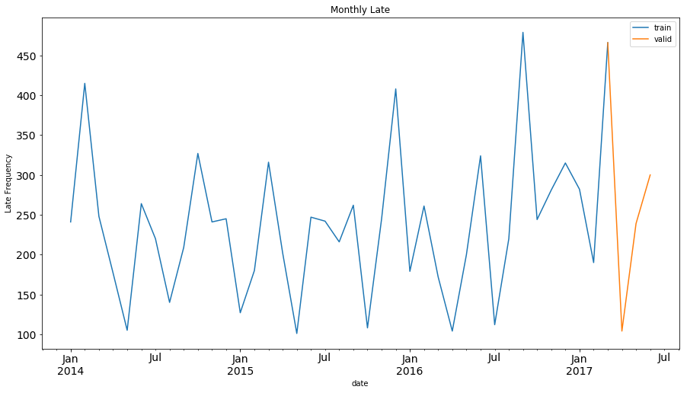
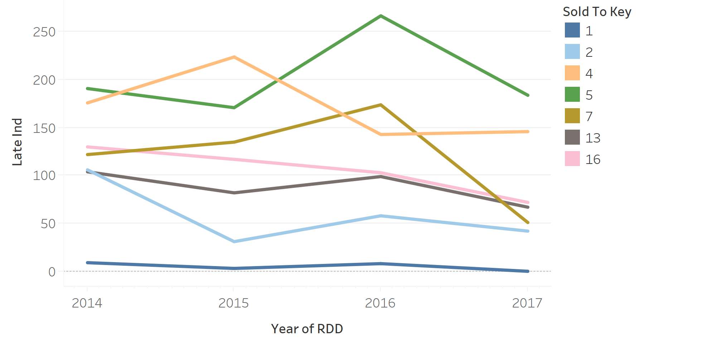
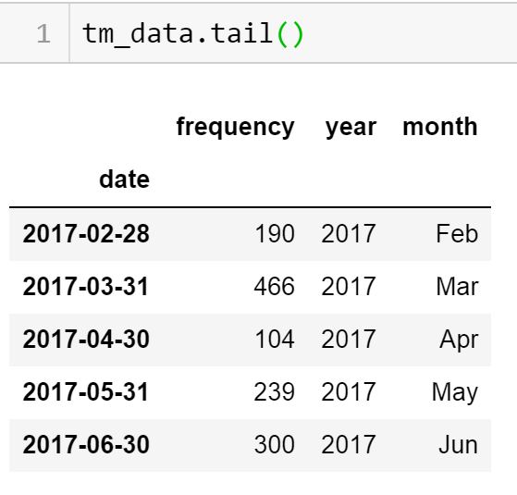
Time Series
Trend of Late Orders
Data Preparation
Splitting Data into Train and Test
Principal drivers

Slide 12
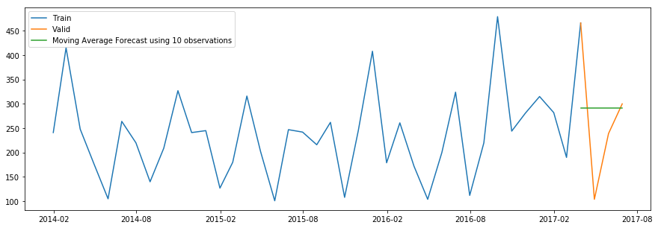
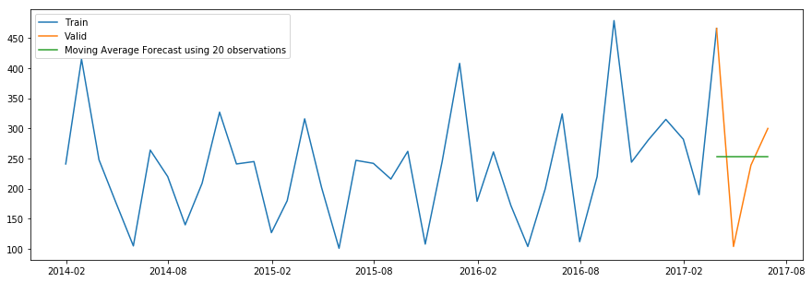
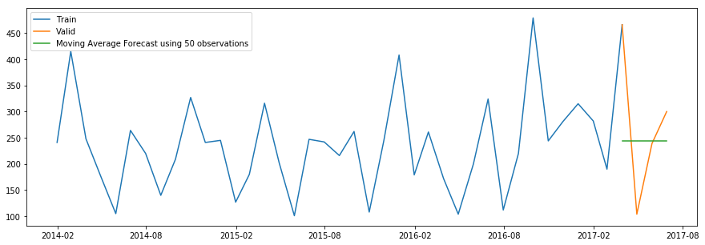
Modelling Techniques
Moving Average:
This technique takes the average of the frequency for last few time periods.
The average of the last 10 , 20 and 50 observations are taken respectively.
The predictions get weaker as the number of observation is increased.
RMSE calculated is 134.4.

Slide 13
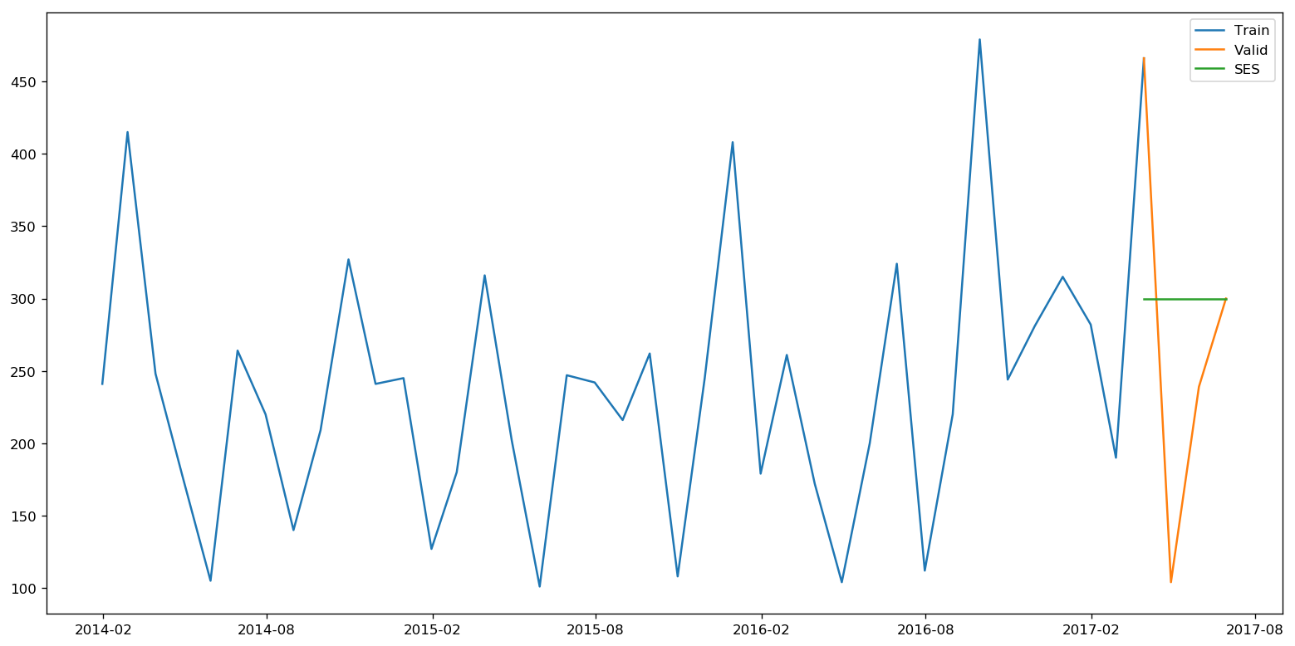
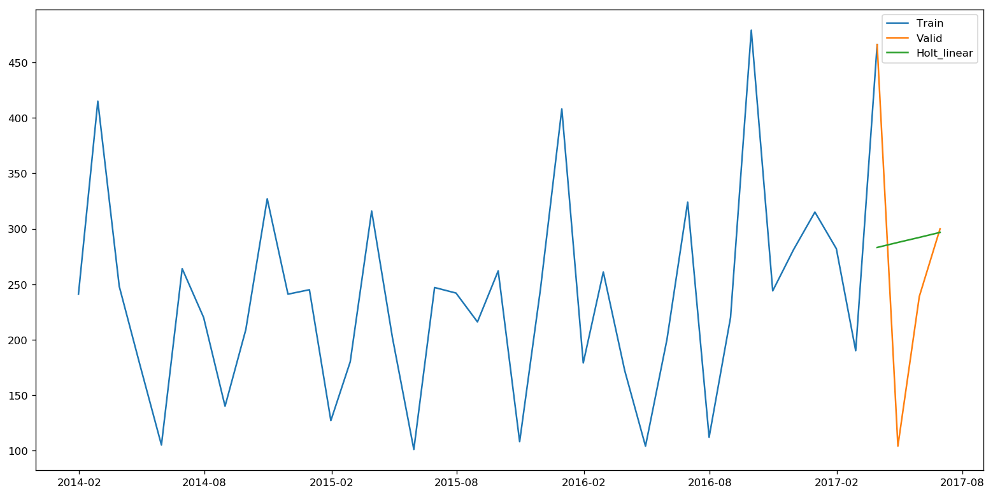
Holt’s Linear Trend Model
Simple Exponential Smoothing:
This is an extension of SES with a trend.
The forecast functions is a function of level and trend.
Smoothing level (alpha=0.2)and smoothing slope(trend)=0.1
RMSE is 142.15
With smoothing level=0.1 RMSE is 132.3
Inclined slope due to inclusion of trend.
This technique assigns larger weight to more recent observations than to observations from the past.
Smallest weights are associated with the oldest observations.
Optimized value of smoothing constant is 0.3
RMSE calculated is 136.78

Slide 14
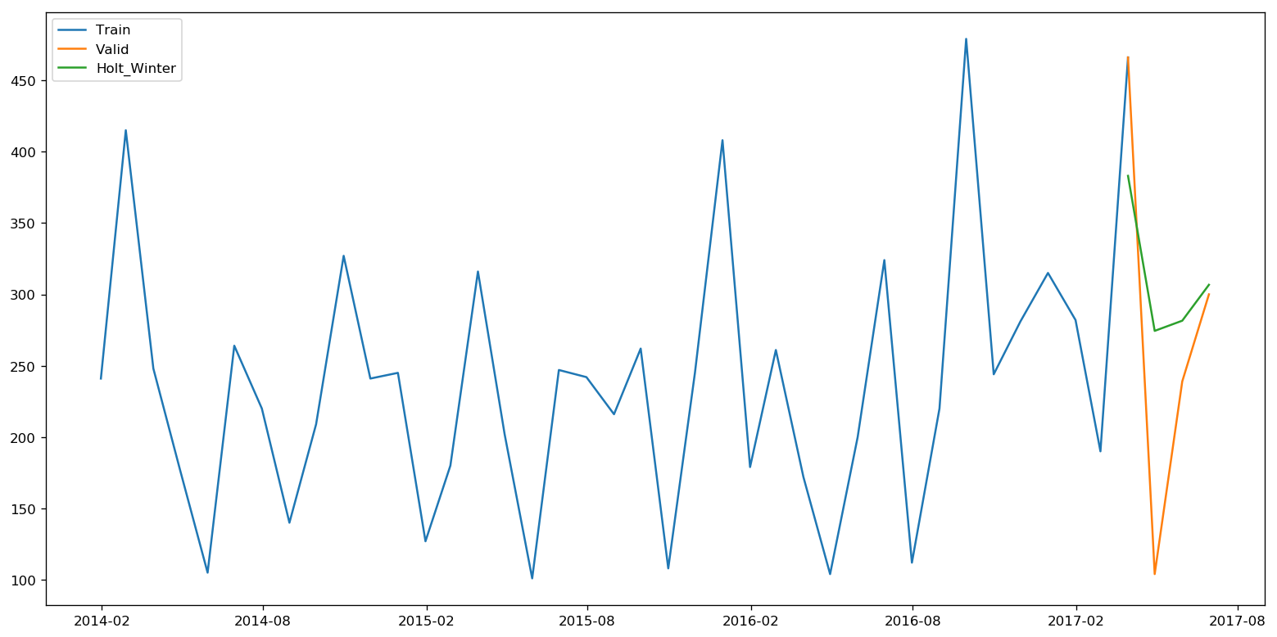
Holt Winter’s model :
This technique takes into account the seasonality of the dataset in addition to level and trend.
RMSE is calculated as 97.18 which shows a considerable decrease from the previous models.

Slide 15
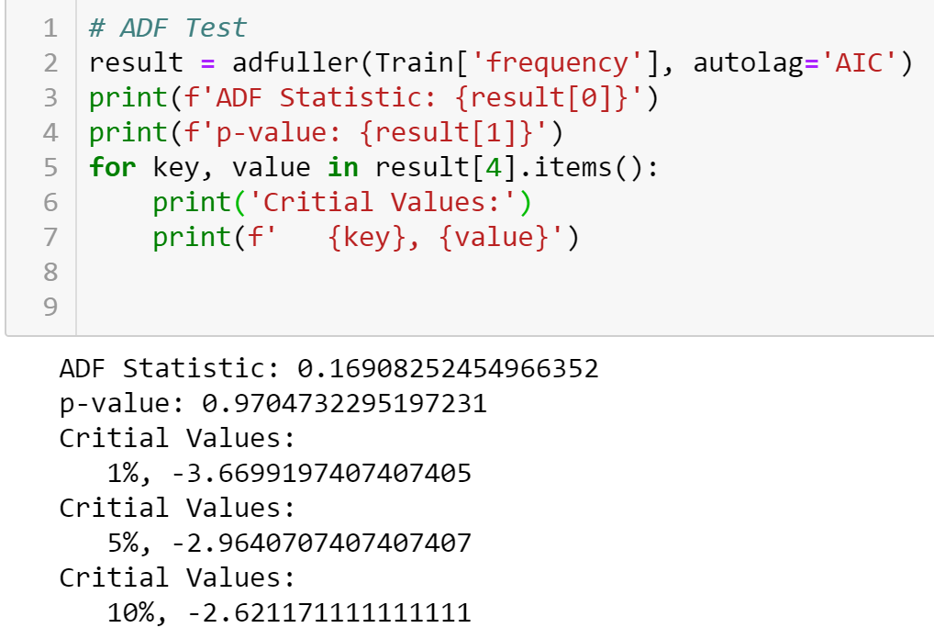
ARIMA Modelling
ARIMA stands for Auto-Regression integrated Moving Average. It is characterized by 3 parameters p,q and d.
Pre-requisite :
The series should be stationary i.e the mean, variance and correlation of the ith and i+1th values should not be a function of time.
Testing stationarity : Dickey Fuller Test
Result:
P-value= 0.97 > significant level[0.05], so I failed to reject the null hypothesis
Need additional data to prove if series is stationary.
Notes:
p is the order of the autoregressive model(number of time lags)
q is the order of the moving average model.
d is the degree of differencing(number of times the data have had past values subtracted

Slide 16
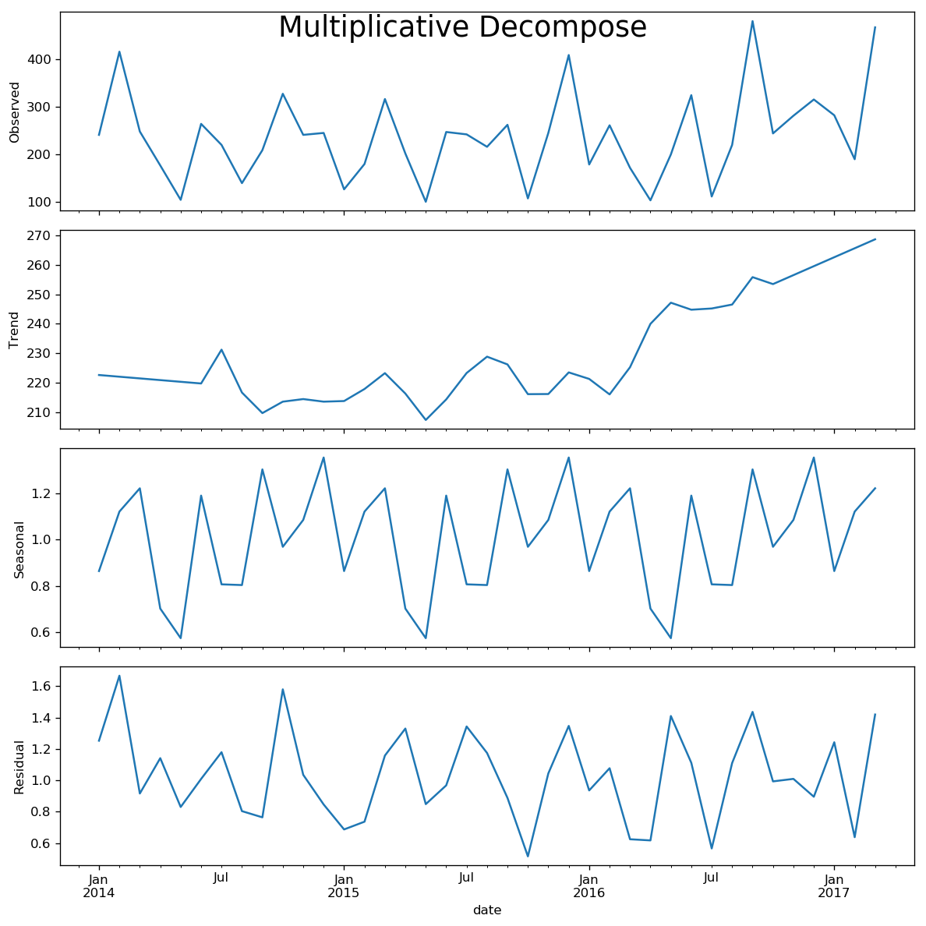
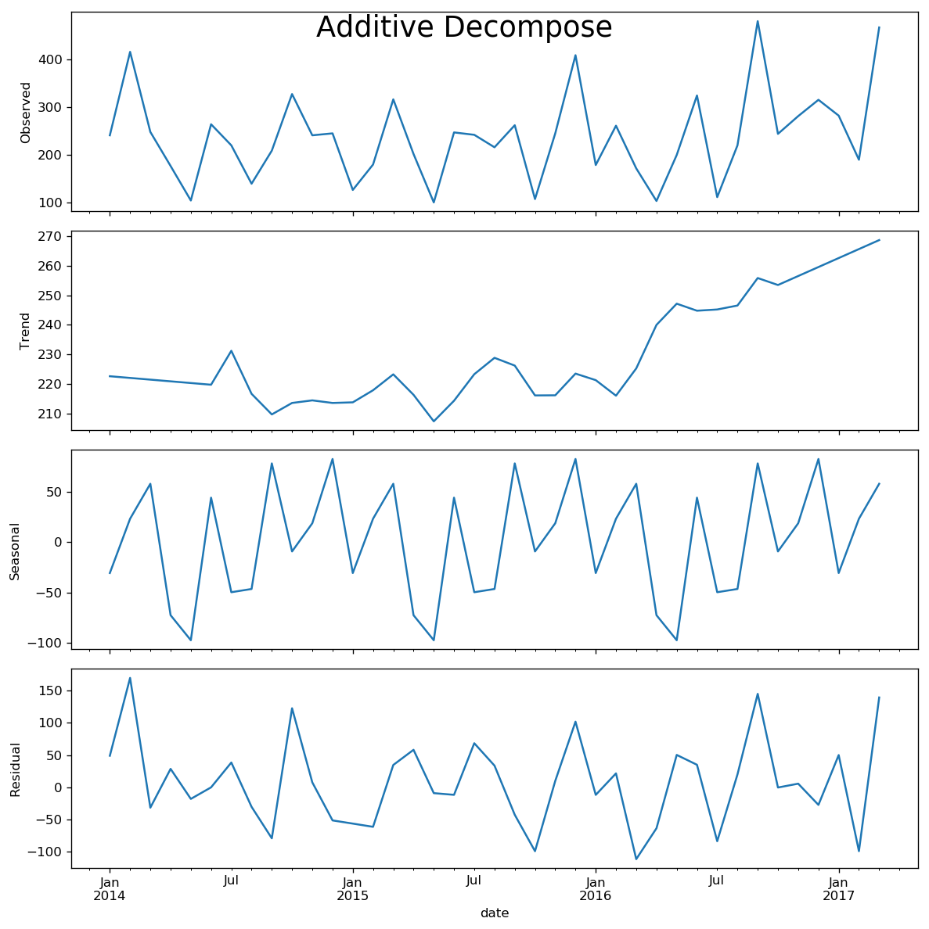
Decomposing Time Series into Components

Slide 17
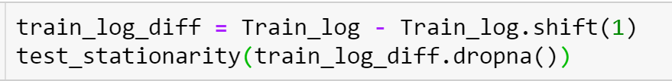
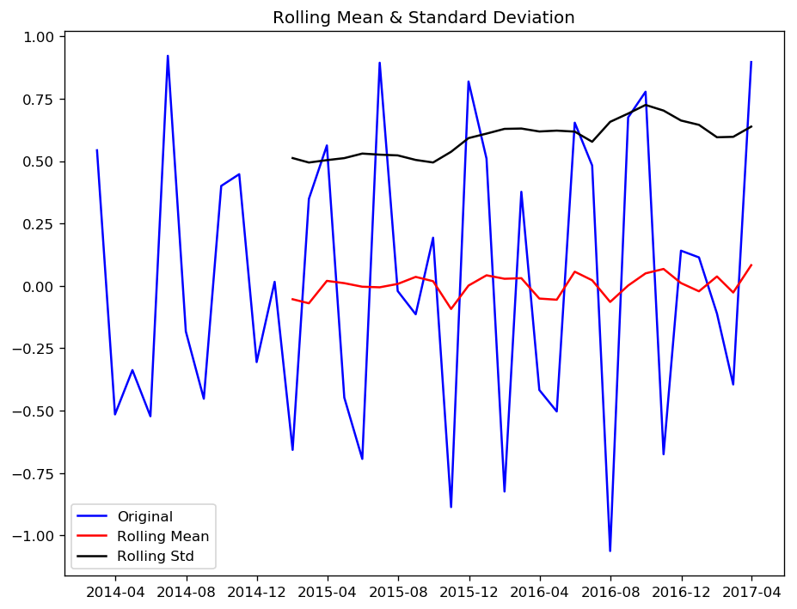
To remove the trend component of the time series.
Results of Dickey-Fuller Test:
Test Statistic -6.037329e+00
p-value 1.372097e-07
#Lags Used 3.000000e+00
Number of Observations Used 3.400000e+01
Critical Value (1%) -3.639224e+00
Critical Value (5%) -2.951230e+00
Critical Value (10%) -2.614447e+00
dtype: float64
Since p-value << significant val=0.05, so we can conclude that trend is almost removed.

Slide 18
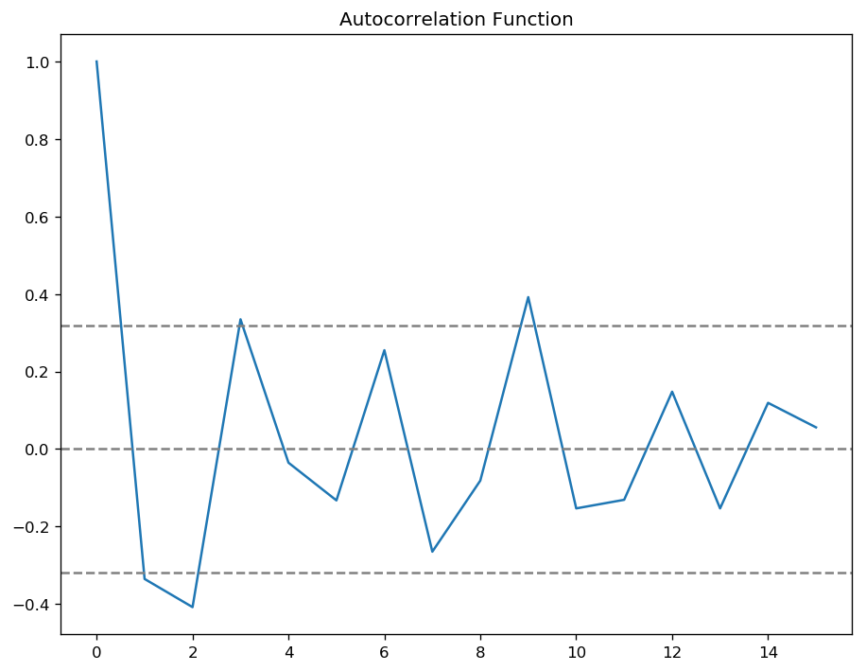
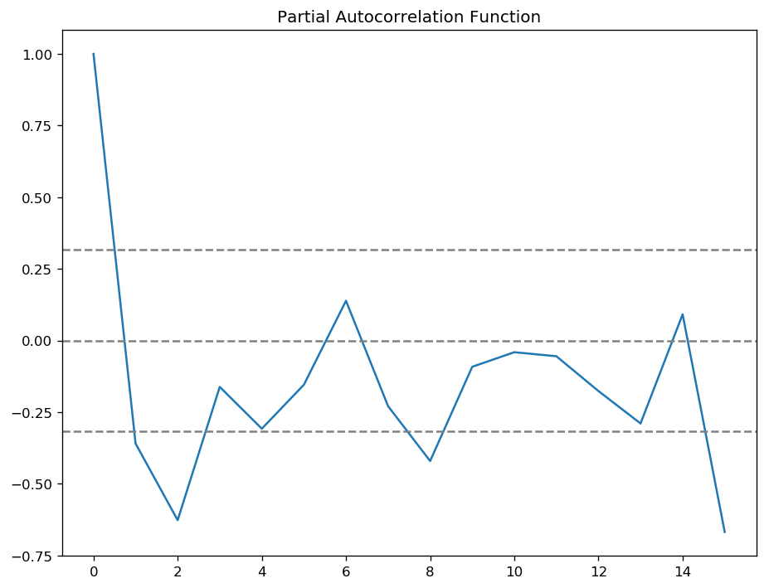
Forecasting Time Series using ARIMA
Determining p, q and d – will use ACF(Autocorrelation Function) and PACF(Partial Autocorrelation Function) graph.
Notes:
P=1, q=1, d=0
p is the lag value where the PACF chart crosses the upper confidence interval for the first time. It can be noticed that in this case p=1.
q is the lag value where the ACF chart crosses the upper confidence interval for the first time. It can be noticed that in this case q=1.
ACF is the measure of the correlation between the Time series and a lagged version of itself
PACF is the measure of the correlation between the Time series and the algged version but after eliminating the variations.

Slide 19
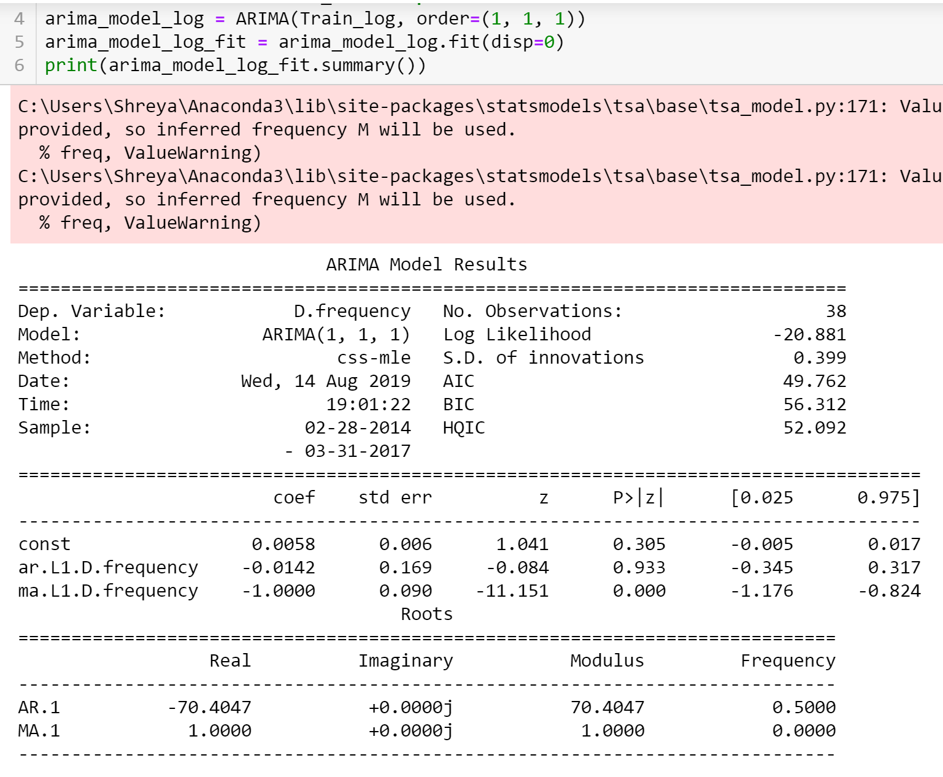
ARIMA Model with p, q, d=1,1,1

Slide 20
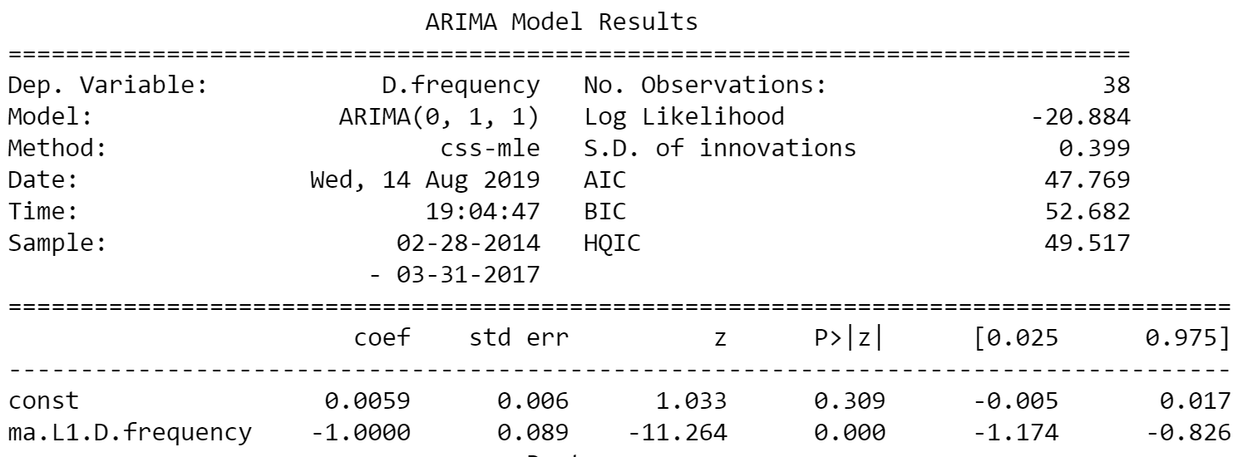
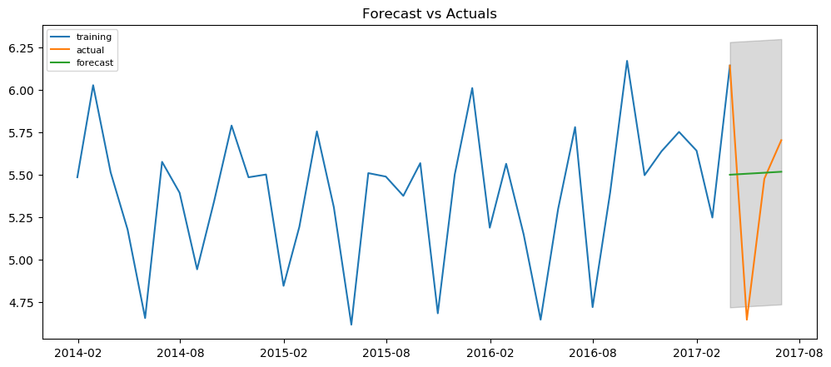
Comparing results of AR, MA and ARIMA model
Forecasting using ARIMA(0,1,1)
AR | MA | ARIMA
P=1,q=0,d=1 | P=0,d=1,q=1 | P=1,q=1,d=1
AIC = 65.65 | AIC = 47.769 | AIC = 46.762
p-val=0.028(significant) | P-val=0.0 | Ar.L1D.freq= 0.933(not sig) Ma.L1 D.freq=0.0
ARIMA Model Results
Model is 91.8% accurate in predicting the next 15 observations
RMSE = 0.5461

Slide 21
Data Modelling to Predict if Order is Late?
Logistic Regression
Residual deviance – 88157 on 446989 dof – Not significant
Random Forest Classification
Cross-validation results- 96.16% accurate

Slide 22
Literature Review
Analysis of Lead Time Delays in Supply Chain: A Case Study - Abdel-Aziz M. Mohamed, Nermeen Country
Analysis of Lead time delays in supply chain studies the lead time data for a multinational company and identify the factors impacting lead time and proposing solutions to the lead time problem. The methodology used in this article is Multiple linear regression where lead time is the response variable and some independent variables used in this analysis are order size, product category and customer class. Lead Time is the time from when a customer requests a delivery till the time when the order was delivered to the customer. It is calculated in ‘days’
Predicting Delivery Time of Components in a Supply chain - Venki Raman
This talks about how late delivery time can lead to unnecessary problems in supply chain and describes different machine learning algorithms implemented to detect late order delivery. It identifies different inputs that can contribute to the machine learning model like supplier or shipment information, method of shipment, weight, volume. Based on the input data and the training, the model can predict a delivery-time for a component. It then proceeds with the different machine learning algorithms that may be used to build the model like Regression analysis, Classification algorithms like Decision Tree, SVM or ANN

Slide 23
Literature Review contd...
Data mining and Data Warehousing for Supply Chain Management
This identifies the issues related to supply chain management and how these problems are taken care of by the help of data mining approaches. The different methodologies used are Naïve Bayes, ANN, SVM or Kernel based SVM (K-SVM). The results confirm that K-SVM outperform the other algorithms in accuracy measures such as MSE, MAPE etc with less average error rate.
Factors Affecting Procurement Lead-Time and Operational Performance in State Owned Financial Institutions in Kenya
AN APPROACH TO IMPROVING CUSTOMER ON-TIME DELIVERY AGAINST THE ORIGINAL PROMISE DATE - G.M. Ramachandran & S. Neelakrishnan
Supply Chain Demand Forecasting; A Comparison of Machine Learning Techniques and Traditional Methods - J. Shahrabi, S. S. Mousavi and M. Heydar

Slide 24
Time Log
Date | Activity | Hours
06-11-19 | 12-1 P.M Call with Dr. Nelson, Lori and the other externship team | 1
06-12-19 | Literature Search | 2
06-13-19 | 10-12 Literature Search | 2
06-14-19 | 18:00 - 19:00 Literature Search | 1
06-15-19 | 10-12 Literature Search | 2
06-16-19 | 10-12 Literature Search | 2
06-17-19 | 11:00 - 13:00 Reviewing the dataset and previous analysis | 2
06-26-19 | 11:30 - 12:30 Church and Dwight externship call | 1
06-28-19 | 09:00 - 11:00 Literature search | 2
07-01-19 | 09:00 -11:00 Project proposal presentation | 2
07-06-19 | 11:00 - 13:00 Documentation (Write-up) | 2
07-07-19 | 14:00 - 16:30 Literature search | 2
07-08-19 | 09:00 - 11:30 Documentation | 2
07-10-19 | 11:30-12:30 C&D Externship call | 1
07-11-19 | 10:00-12:00 Data Cleaning 17:00-18:00 study | 3
07-12-19 | 18:00-20:00 Data cleaning | 2
07-12-19 | 09:00-11:00Self study | 2
07-13-19 | 10:30-13:30Visualization | 3
07-13-19 | 10:15-11:15 Self-study 18:30-19:45 - data cleaning | 2
07-14-19 | 09:00-11:00 Data Cleaning | 2
07-14-19 | 17:00 - 20:00 Self study | 3
07-15-19 | 09:30-12:30 Exploratry Data Analysis | 3
07-16-19 | 14:30-15:30 Exploratry Data Analysis | 1
07-17-19 | 09:30-12:30 Self Study | 4
07-17-19 | 12:00 - 13:30 Team meeting | 2
07-18-19 | 10:30-12:30 Exploratry Data Analysis | 2
07-18-19 | 09:30-12:30 Visualization | 3
07-19-19 | 14:20 - 19:00 Exploratry Data Analysis | 4
07-20-19 | 09:30-12:30 Exploratry Data Analysis | 2
07-20-19 | 09:30-12:30 Visualization | 2
07-21-19 | 09:00-11:00Exploratry Data Analysis 15:00 - 18:15- Attribute scaling | 5
07-22-19 | 14:20 - 19:00 Outlier detection | 5
07-22-19 | Self study | 3
07-23-19 | Visualization | 1
07-24-19 | 09:00-11:00 outlier removals | 2
07-24-19 | 19:30-20:30Time series analysis | 2
07-24-19 | 14:30-15:30 Exploratry Data Analysis | 1
07-24-19 | Presentation to the team | 2
07-25-19 | Study | 2
07-26-19 | Documentation | 4
07-27-19 | Feature Selection | 3
07-28-19 | Time series analysis | 5
07-28-19 | Self study | 2
07-29-19 | 13:00-15:00 Poster | 2
07-30-19 | 18:30-20:30 Poster | 2
07-31-19 | 09:00-12:00 Feature selection Sick | 4
08-01-19 | Poster | 3
08-02-19 | Poster | 4
08-02-19 | Time series analysis | 5
08-03-19 | Feature Selection | 2
08-04-19 | 10:30-12:00Modellinh | 2
08-04-19 | 18:30-20:30 Study | 2
08-05-19 | Documentation | 2
08-05-19 | Self study | 2
08-06-19 | Feature Selection | 2
08-06-19 | Time series analysis | 3
08-07-19 | 10:00-13:00 - Modelling 19:00 -21:00 Poster Presentation | 6
08-08-19 | Modelling | 3
08-09-19 | 08:00-13:30 Documentation | 5
08-09-19 | 08:00-13:30 Documentation | 5
08-10-19 | 17:30-22:30 Documentation | 4
08-11-19 | 14:00 - 22:30 Documentation | 8
08-11-19 | 09:00 - 12:00 Arima modelling | 6
 | Total : | 174

Slide 25
Thank You!

